Slide 1
WORLD OF DRONE
Drone Application: Surveying

Slide 2
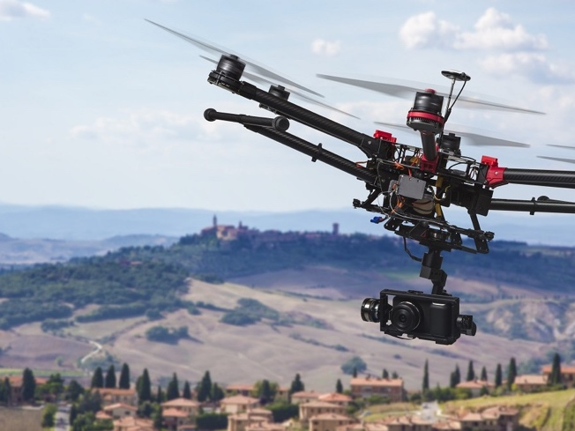
Drone Application: Surveying
UAVs can be used to perform geophysical surveys, in particular geomagnetic surveys where measurements of the Earth's varying magnetic field strength are used to calculate the nature of the underlying magnetic rock structure.

Slide 3
Drone Application: Surveying
For monitoring oil and gas pipelines above the ground using digital cameras integrated into UAVs.

